Slide 1
Foundations of Social and Cultural Data Analysis
Dr. Nanne van Noord & Dr. Melvin Wevers

Slide 2
Common Summary Statistics

Slide 3
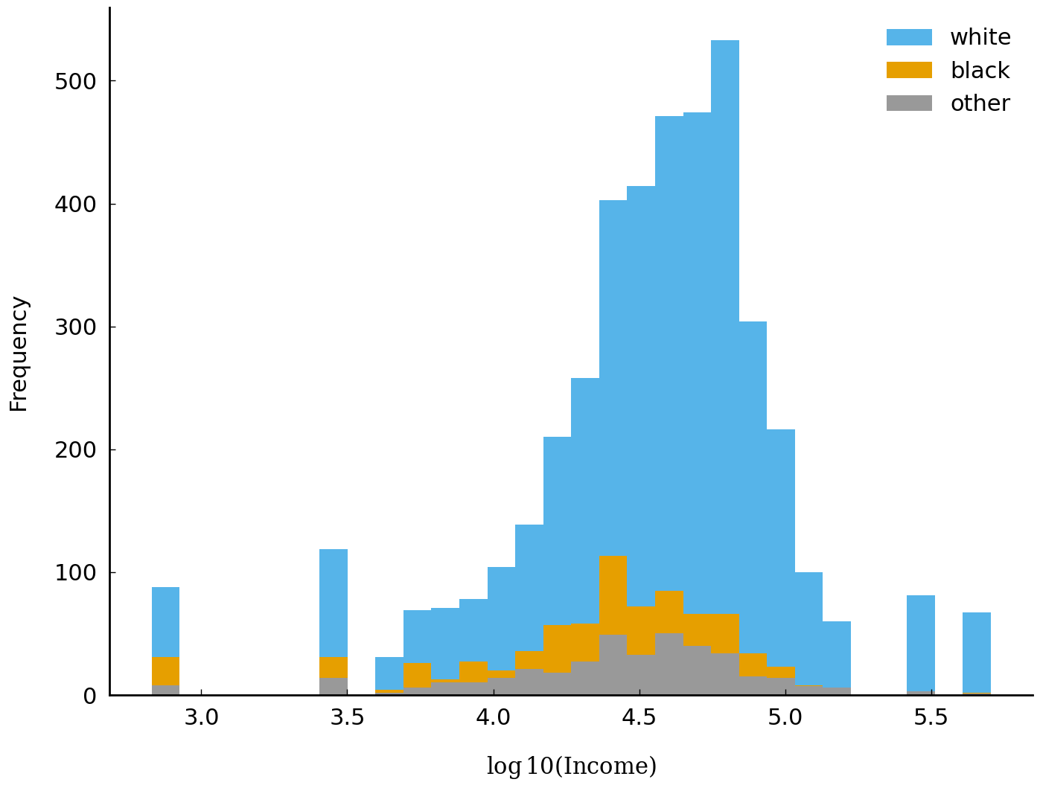
Logarithmic scale
For skewed data, we often rely on the logarithm. This makes smaller differences more visible
The base-10 logarithm of a number x is the power to which 10 must be raised to obtain x
10² = 100
Log₁₀ (100) = 2

Slide 4
The Mean: Capturing the Average
Definition: The mean is the average of all numbers in a dataset.
Pandas: .mean()
Calculate the mean age of Nobel laureates in Literature.

Slide 5
The Median: Finding the Middle
The median is the middle value in a sorted dataset.
Example: Determine the median year of significant historical events.
The media is less sensitive to outliers, more robust, it also gives an actual value from the dataset.

Slide 6
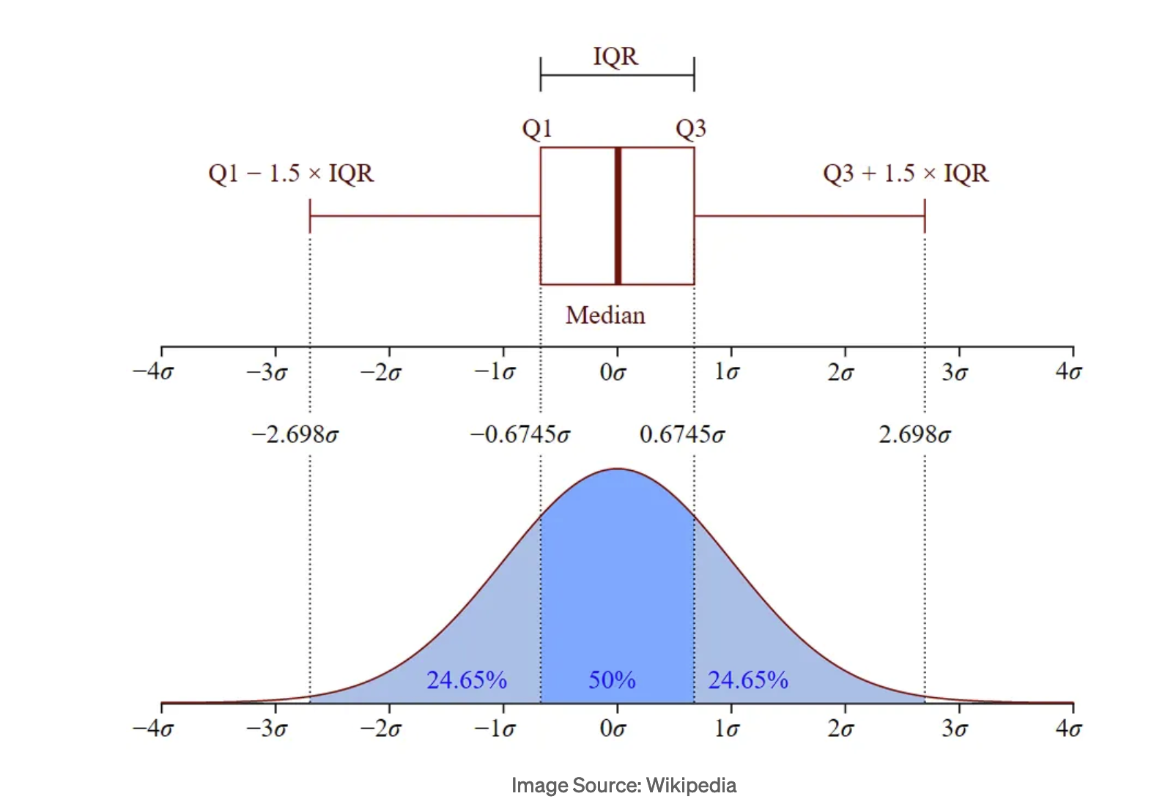
Dispersion: Standard Deviation and Variance
Standard deviation
  measures the amount of variation or dispersion in a dataset.
Variance
  the average of the squared differences from the Mean
Mean Absolute Deviation
  the average of the absolute differences between each datapoint and the mean of the dataset
Interquartile Range (IQR)
  Difference between the upper and lower quartiles of the dataset
    IQR = Q3 (median of the upper half) - Q1 (median of the lower half)

Slide 7
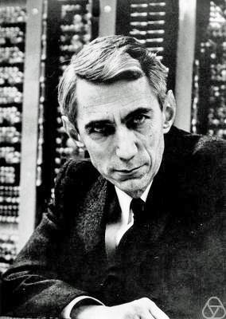
Entropy
a measure of the unpredictability/uncertainty or surprise of information
how much information is needed to describe a certain state or how unpredictable a source of information is.
Developed by Claude Shannon in 1940s
The more unpredictable or varied the information, the higher its entropy.
We can also use it to express the diversity of categorical values
  Low entropy is less diverse
Claude Shannon

Slide 8
Concept of Entropy: Yes or No Questions
How many yes-or-no questions would it take to transmit a seven-day weather forecast?
Are all days going to be sunny? (Yes)
If you need more questions, there is more unpredictability, and entropy increases

Slide 9
Entropy for Humanists
Language and Text: Entropy can be used to measure the richness or complexity of a language or piece of text. For example, a text with a very limited vocabulary and repetitive phrases has low entropy because it's predictable. In contrast, a text with a diverse vocabulary and varied sentence structures has high entropy, reflecting its complexity and the amount of information it conveys.
Cultural Trends: Just as entropy measures the unpredictability in data, it can metaphorically apply to cultural phenomena. High entropy in a cultural context could mean a diverse and rapidly changing culture with many influences and outcomes. Low entropy could indicate a more uniform, stable culture with predictable patterns.
Historical Analysis: Historians can use entropy to understand the diversity of events or influences over time. High entropy periods in history might be those with chaotic, unpredictable events (like revolutions or social upheavals), while low entropy could denote stable, unchanging periods.

Slide 10
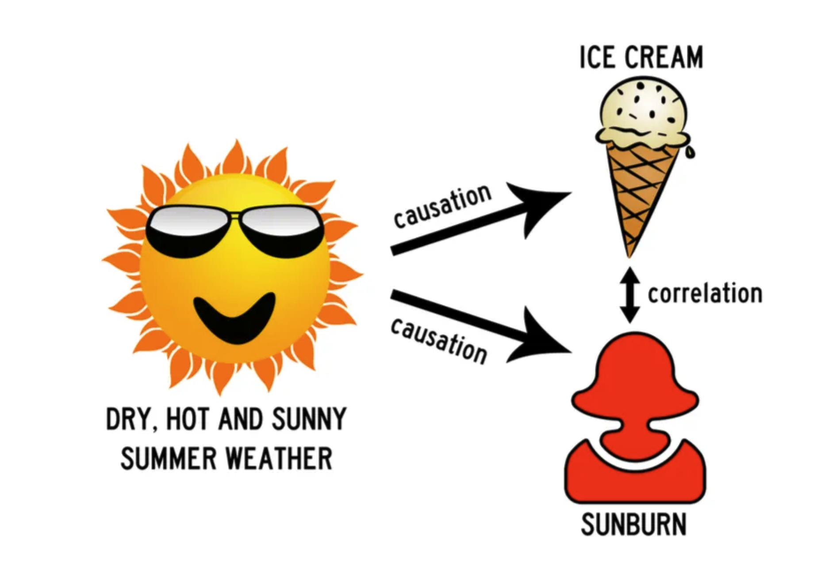
Measuring Associations: correlation is not causation

Slide 11
Correlation
Spearman’s and Kendall’s rank correlation coefficient are measures used to assess the strength and direction of the association between two ranked variables (i.e. they are ordered)
Interpretation:
  -1 is a negative correlation (one goes up the other goes down)
  0 no correlation
  1 is a positive correlation (one goes up and the other also goes up)
Use Spearman's for ranked data or when dealing with non-linear but monotonic relationships, especially with outliers or skewed distributions.
Use Kendall's in situations with small samples, many ties, or when a more robust measure against non-linearities and outliers is needed.
For continuous data use Pearson’s correlation

Slide 12
Mutual Information
Concept from information theory that measures the amount of information one variable contains about another
Related to entropy
It quantifies how much knowing about one variable reduces your surprise or uncertainty about the other (goes beyond linear correlations)
Higher MI indicates more dependence between variables

Slide 13
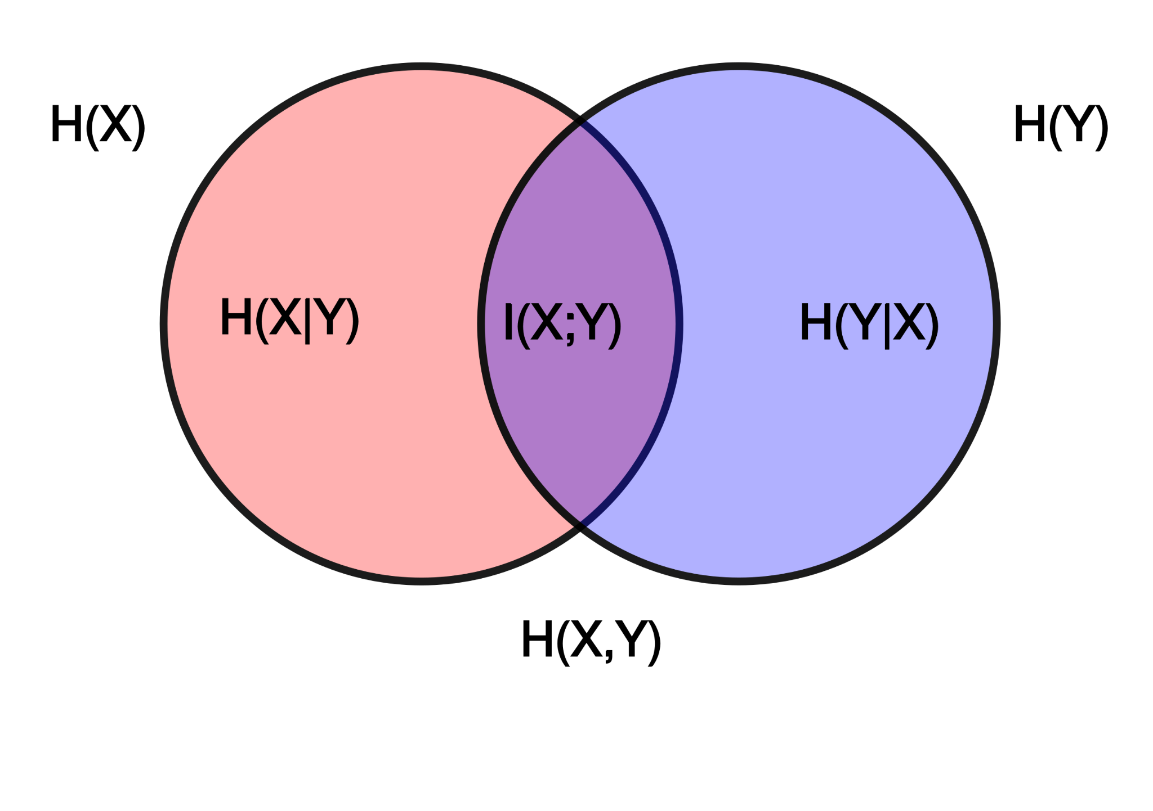
Mutual Information Example
Imagine you're analyzing a set of novels to understand the relationship between the setting (e.g., urban vs. rural) and the theme (e.g., romance vs. adventure). Mutual information could quantify how much knowing the setting reduces uncertainty about the theme.
If mutual information is high, then knowing the setting gives significant insight into the likely themes of the novel; if it's low, the setting doesn't tell you much about the theme.

